Slide 1

PREDICTING BULLWHIP EFFECT USING MACHINE LEARNING
Publication: International Conference On Advances in Management and Technological Innovations Impacting Industries
(April 20th – 22nd, 2021) ( Scopus Indexed conference)
Submitted by:​
ABHINAV DISKHIT​ | 2K17/ME/008​
ABHIRUP PODDAR​ | 2K17/ME/009​
ARHAM ANWAR​ | 2K17/ME/059​

Slide 2
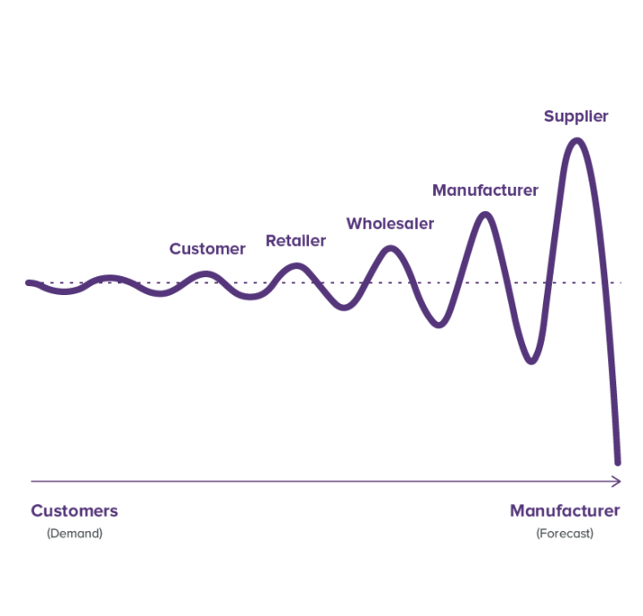
What is Bullwhip Effect
The bullwhip effect is a distribution channel phenomenon in which demand forecasts yield supply chain inefficiencies.
It refers to increasing swings in inventory in response to shifts in consumer demand as one moves further up the supply chain.
The bullwhip effect is caused by:
Demand forecast updating: Members of the supply chain updating their demand forecasting
Order batching: Members of the supply chain rounding up or down the quantity of orders
Price fluctuations: Usually driven by discounting resulting in larger quantities of purchases
Rationing and gaming: Buyers and sellers delivering over or under their order quantities

Slide 3

Example
A retailer sells on average 10 ice creams per day in the summer season. Following a heatwave the retailer's sales increase to 30 units per day.
Hence, the retailer increases their demand forecast and orders 40 units per day in order from wholesaler, this creates the first wave in the exaggerated demand being driven down the supply chain.
The wholesaler noticing this increase in demand from the retailer may then order 60 units from manufacturer rather than ordering 40 units to be manufactured
The manufacturer increases their manufacturing run to 80 units, this creates a third wave in the exaggeration of demand.
The retailer may take the option of switching to an alternative brand to meet customer demand, this will then create a false demand situation.
Alternatively, if the weather changes and the end consumers slow down on purchasing ice creams, this could result in an overstock situation across the supply chain.

Slide 4
Literature Review
The causes of the Bullwhip effect can be divided into two, operational and behavioral. The operational reasons for the bullwhip are mentioned below,
Amplification of demand order variation (Lee et al 1997)
Lack of coordination between stakeholders in the supply chain (Bhattacharya et al 2011)
Lack of transparent information sharing (Bhattacharya et al 2011)
Excess inventories throughout the supply chain to avoid stockout (Suki 2009)
Inventory Stock-outs (Sun et al 2005)
The conventional ways to mitigate these are
Information Sharing (Li et al 2013)
Improved demand forecasting (Disney et al 2003)
Replenishment policy (Kim et al 2010)
Reducing the lead time (Li et al 2013)

Slide 5
Literature Review
Artificial Intelligence and BWE: Prakash et al, 2014 suggested the integration of artificial intelligence in the supply chain to mitigate the bullwhip effect by directly monitoring the demand forecasting and order batching with the aid of machine learning algorithm
Research Gaps There aren’t many papers which address the behavioural causes of the bullwhip effect. Mitigating the behavioural causes of the bullwhip effect could help us reduce the effect which plagues the supply chain. Moreover, there has been a lack of artificial intelligence tools because of the lack of research on the causes. (De Almedia et al 2015) As mentioned earlier, artificial intelligence can prove to be fruitful in order to reduce the bullwhip.
Research objectives: The objective of the paper is to investigate the behavioural cause of the bullwhip effect. Model a 4 stage supply chain model using the principle of industrial dynamics laid down by Forrester in 1961 and Sternman’s beer game (1983). The data collected from the model is subsequently used to construct 3 artificial intelligence models which aim to predict the bullwhip effect.
Notes:
Break order batches Placin

Slide 6
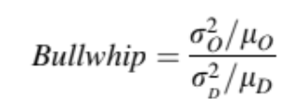
Quantifying Bullwhip
Operational research formulates the problem as a differential equation. The mathematical solution attempts to minimize a cost function subject to operation conditions. In many cases, the ratio between orders variance and demand variance is employed.
It describes the existing ratio between variance and the arithmetic mean. A ratio higher than one indicates variance amplification, and below one implies an isolation effect.

Slide 7
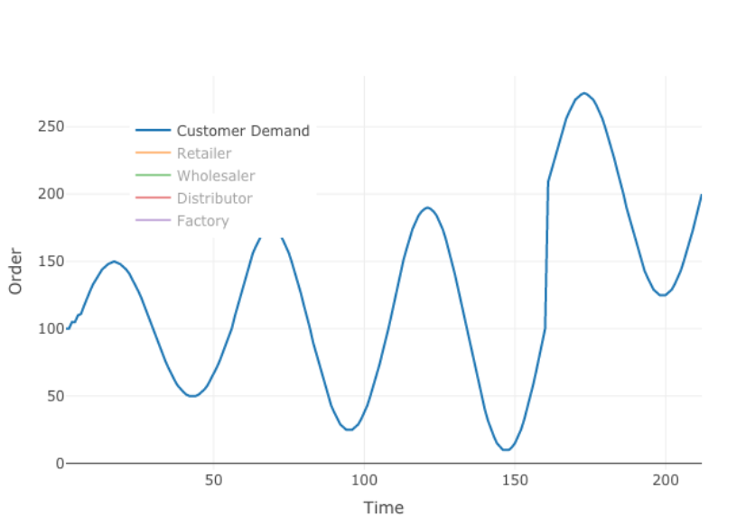
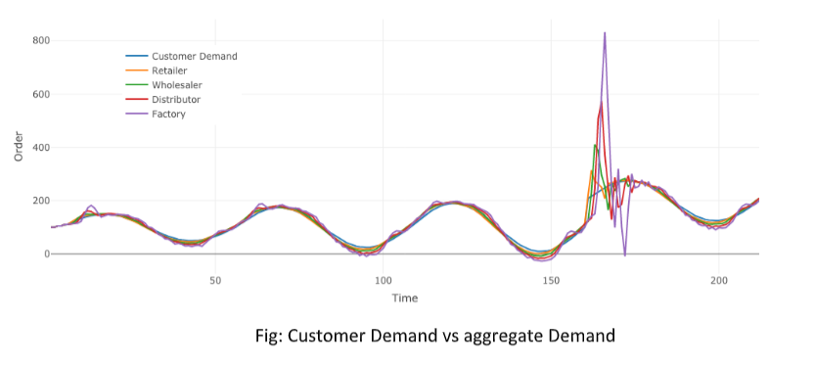
Creating Dataset
The data is generated using the bullwhip game. This section shows plots of demand of customer in supply chain. To implement variability in the demand, the customer demand is simulated using a sinusoidal curve as shown in the figure below.
Consequently, The following graphs for demand for the following are obtained and displayed below :

Slide 8
Preparing Dataset
In order to use the data, data preprocessing is required. The process of data pre-processing has the following steps.
1. Data Exploration
In this process, the data is checked for any inaccuracies such as missing values, typographical
errors etc.
2. Data Cleaning
In this process, all the unnecessary and incorrect data points are removed in order to increase the
accuracy of the data table.
3. Data Processing
In this process, all the labelled data is encoded with a numerical value. The data table is scaled for
the machine learning algorithms. The dataset is further split into testing and training dataset.

Slide 9
Selecting Machine Learning Algorithms
The following algorithms were chosen:
KNN
Multi Layer Perceptron Regressor
Decision Tree
The split between training and testing data is 75% and 25%
The proposed machine learning model has nine inputs namely Cost, Order, OUT, SS, LTD, NS, Forecast, Receive and Demand. Bullwhip will be the forecasted output of the model. The computed output, is the numerical value of the bullwhip effect.

Slide 10
Results
A correlation Matrix was constructed to understand the correlation between bullwhip and the various inputs.
Accuracy of prediction with different algorithms
S.no. | Algorithm | Accuracy
1 | Decision Tree Regressor | 24.52%
2 | MLP Regressor | 25.32%
3 | KNN Algorithm | 54.64%
Accuracy of MLP: The given dataset had a small resolution of upto 2 decimal places. Due to this small resolution, the algorithm is unable to differentiate and predict the bullwhip effect with a high degree of accuracy.
Accuracy of KNN: Since the projection of the 9 input variables were plotted against the numerical value of bullwhip. The machine found the most accurate result at K=5 or 5 clusters. The algorithm dealt with multi collinearity easily
Accuracy of Decision Tree: Due to high multi-collinearity between the input data points. The Regressors failed to model the bullwhip. Certain variables need to be removed to get a higher prediction score.

Slide 11
Findings
The objective was to study the bullwhip effect, underlying causes and
possible remedies of the bullwhip effect in supply chains. Coordination and collaboration among partners of a supply chain with time bound information sharing is a possible remedy to the demand amplification phenomenon. However, the full integration of the organizations of a supply chain is not possible due to difference of strategies and goals existing among them.
In absence of integration among partners the increase in accuracy of demand information will help to reduce the bullwhip effect. Hence, the appropriateness and effectiveness of bullwhip forecasting using artificial intelligence technique, artificial neural networks is a valid and practical approach to mitigate the inefficiencies due to the amplification in variance of demands.
The results of this project show that the artificial intelligence technique, artificial neural network forecasts accuracy can be achieved with further investigation into the phenomenon. Future research could be directed towards applications of other artificial intelligence techniques like genetic algorithms and fuzzy logic in Bullwhip forecasting.

Slide 12


